Slide 1

Online Home Repair System
Submitted By
Sazzad Hossain → 1610139042
Prasanto Dey → 1621310042
Anika Bin Wasim → 1631297042
Faculty Advisor
Dr. Mohammad Ashrafuzzaman Khan

Slide 2
Design of The Project
Our works visually using diagrams:
Home Page
Header section has: Home, Cart, About, Plumbing service, Login and Electrical service.
Body section has: Service lists, Subscribe to your newsletter and Map.
Footer section has: About, Career, Community Guideline, Terms and Conditions, Privacy Policy, Facebook page link, Twitter page link, Youtube page link, Instagram page link, Blog page link, How It Works, Earn Money, Frequently Asked Questions, Become A Service Provider, Login As Serviceman or Manager, Login As Product Manager.
Employee Management System
Header section has: Home, Main Service Page, Contact, About Us, Employee Login and Admin Login.
Employee Dashboard: HOME, My Profile, My Projects, Apply Leave, Log Out
Admin Dashboard: Home, Add Employee, View Employee, Assign Project, Project Status, Salary Table, Employee Leave, Job Applications, Log Out
Customer Profile
Personal Info: First Name, Last Name, Email, Phone, Address.
Product Management System (Only accessed by admins)
Header section has: Log out.
Left vertical navigation section has: Home, Orders, Menu, Category List Users, Site Setting.
Database

Slide 3
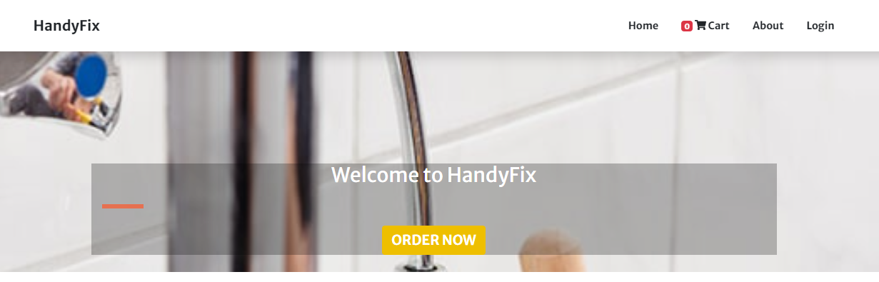
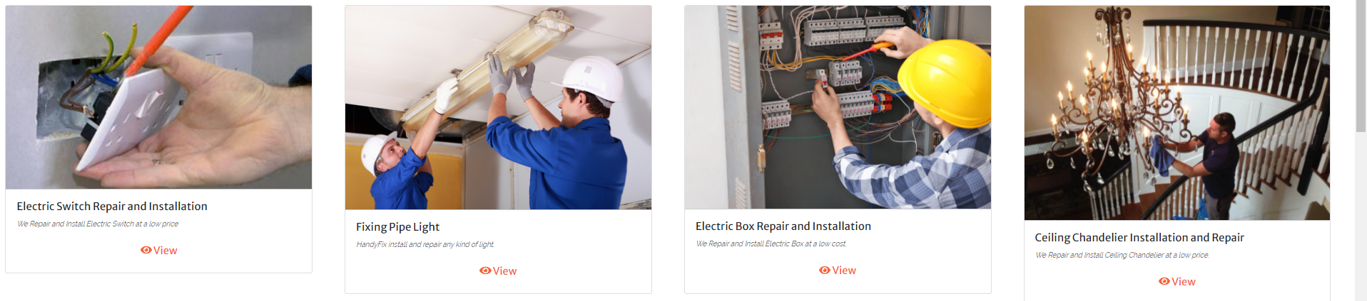
Design of The Project
Our Individual contributions
Discussion of our contribution given below:
Sazzad created Home option, cart page, About us page, Login option.
Frontend design were created by Sazzad.
Static version of Plumbing and Electrical service categories were created by Prasanto. Then Sazzad and Anika made the Plumbing services dynamic.
Sazzad made Electric services dynamic.

Slide 4
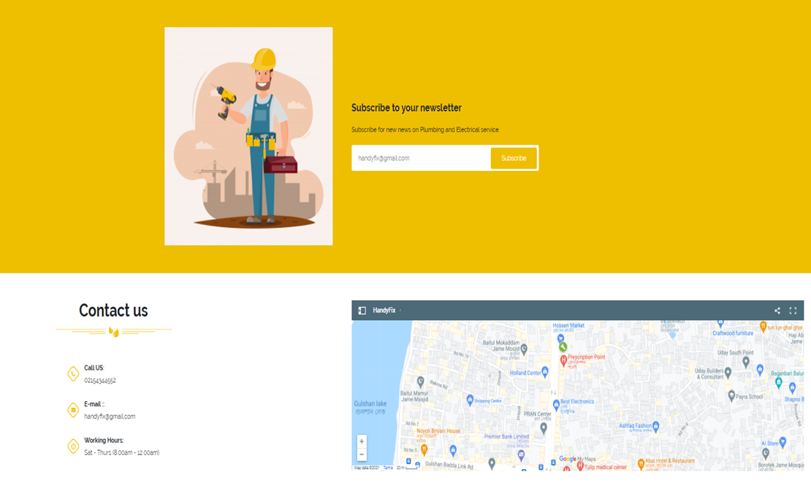
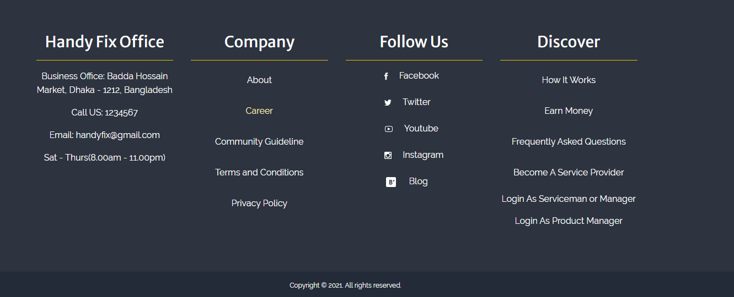
Design of The Project (Continued)
Our Individual contributions (continued)
Subscribe to your newsletter option, Contact us section and Map were created by Sazzad.
At Footer under Company heading, About page, Career page were created by Sazzad, Community Guideline page were created by Prasanto, Terms and Conditions Page were created by Anika and privacy policy page were created by Sazzad.
At Footer Facebook, Twitter, YouTube, Instagram, Blog links were created by Sazzad.
At Footer under Discover heading, Anika created How it works page, Prasanto created Earn money and Frequently asked questions page and Sazzad created Became a service provider, Login as serviceman or manager, login as product manager page.

Slide 5
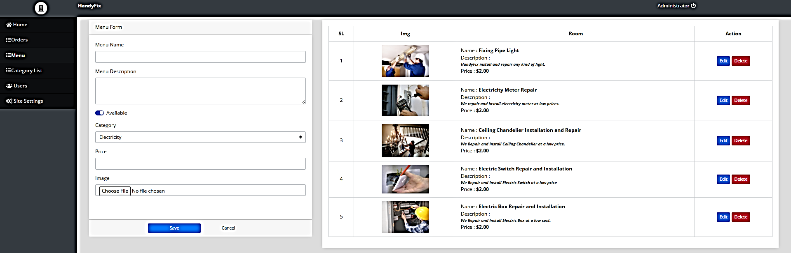
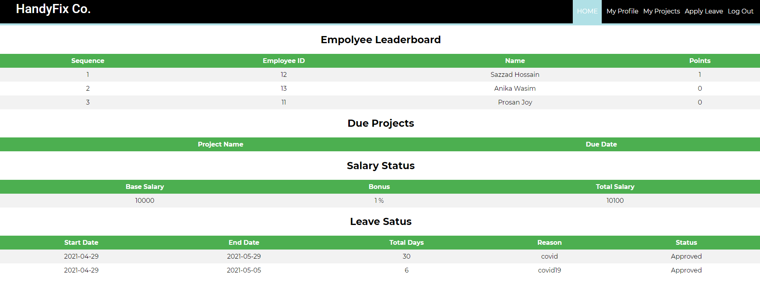
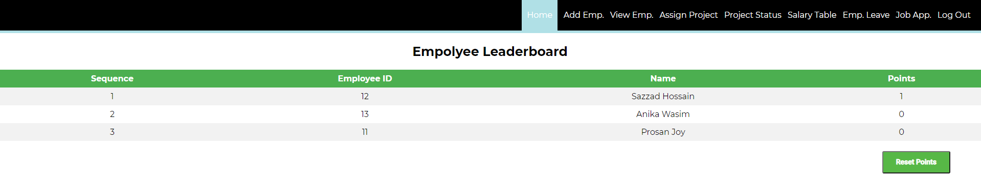
Our Individual contributions (continued)
Product management System were created by Sazzad and contains Home, Orders, Menu, Categories, Users and Site settings.
Employee management System Serviceman Dashboard were created by Sazzad and contains Home, My profile, My projects, Apply leave and log out.
Employee management system Admin Dashboard were created by Prasanto and Anika. Prasanto created Home page, Add Employee page, View Employee, Assign Project page, Logout page. Anika created, EMS Contact page, EMS About Us page, admin project status page, admin salary table page, admin Job application page.

Slide 6
Design of The Project (Continued)
Teamwork
Our teamwork helped us a lot. From the beginning of the project we discussed about related works on website, so that we can do feature selection for our website.
We talked about updates of our website and how we should merge our works.
We heaped each other to understand our works.
We always selected the time of our meeting by discussing with every member of our group.
Results Analysis
The Results We Got
Our website’s customer sign up, login and profile work perfectly.
We can add service to cart and increase and also decrease the quantity of service.
Our payment system works.
We can add and delete product from Product Management System of our website.
Orders can be approved by admin from Product Management System.
At Employee Management System Serviceman login and Admin login works perfectly.
At Employee Management System Serviceman Dashboard serviceman can update profile info and password.
At Employee Management System Serviceman Dashboard serviceman can apply for leave.
Service man can see assigned works from their account after login.
After providing service serviceman can mark assigned work by admin as done from account.
Service providers can successfully log out from their account.
At Employee Management System Admin Dashboard Admin can see leaderboard and reset it.
Admin can add and remove employee after taking proper interview from Admin Dashboard.

Slide 7
Results Analysis
The Results We Got (continued)
Admin can view employee list from Admin Dashboard.
From Admin Dashboard admin can assign works to service providers.
Admin can check from Admin Dashboard that if the serviceman did the works or not.
Admin can see salary table and give points to service providers based on their works. This points will be add as bonus in serviceman’s salary.
Admin can see leave request of the employees and can approve requests and also can cancel requests.
Job application can be seen from Admin Dashboard.
Observation from Result Analysis (Results make sense or not)
We observed from our website that everything (frontend, backend and database) works perfectly as we expected. Our website is ready for service.
Individual Contributions in Result analysis
Sazzad’s Analysis: Ensured the webpages and database connections are working, those were made by him.
Prasanto’s Analysis: Ensured the webpages and database connections are working, those were made by him.
Anika’s Analysis: Ensured the webpages and database connections are working, those were made by her.

Slide 8
Future Works
The Works We Want to Do in The Future
We want to implement a map in Employee Management System. So that Service Providers can easily find out the customer address locations.
In our system besides cash on delivery we want to add digital payment system like bKash, Nagad, Rocket, Credit card and Debit card.
We want improve our site’s security. It will ensure the safety of customer, service provider and admin information data.
In our system we want to set up a Chat-Bot. So that customer can learn information about our services.
We want to set up a Notification System in Employee Management System. Service Providers will be able to know their new assigned works through notifications.
We want add more services in our website besides Plumbing and Electrical services. For instance, Cleaning, Laundry, Car rental and CCTV services.
Launch our website by web hosting.

Slide 9
Thank You.
Any questions?

